Slide 1
Extractor
Accelerating anode
Gun lens
Gun deflection coils
Condenser lens 1 (C1)
C1 aperture
Condenser stigmator
C2 aperture
Beam deflection coils
Minicondenser lens
Upper objective lens polepieces
EDX detector
Specimen
Lower Objective lens polepieces
Objective aperture
SAED aperture
Diffraction lens/Immediate lens
Projection lens 1
Projection lens 2
Phosphor screen
Entrance aperture
EELS spectrometer

Slide 3
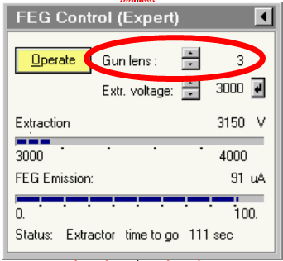
Gun Lens
The gun lens is an electrostatic lens positioned directly behind the field emitter and extractor
Increasing gun lens leads to reduction of the beam size and current.
Increasing the gun lens by 1 leads to a reduction of the beam current by approximately 35%.
sets the first beam crossover which is in turn the object of the first condenser lens
Gun lens 5
Gun lens 8
Gun lens
1
Gun Lens
2

Slide 4
Spot Size Control
Gun lens
C1
C2 and C2 aperture
Minicondenser lens
Upper objective lens
Create a demagnified image of the gun crossover
Control the minimum spot size obtainable in the rest of the condenser system.
Determines the beam current on the specimen
Increasing the spot size by 1 leads to a reduction of the beam current by approximately 50%.
1
11
Spot Size

Slide 5
Intensity Control
Gun lens
C1
C2 and C2 aperture
Minicondenser lens
Upper objective lens
intensity
The convergence of the beam at the specimen.
Diameter of the illuminated area of the specimen
Determines the electron dose on the specimen

Slide 6
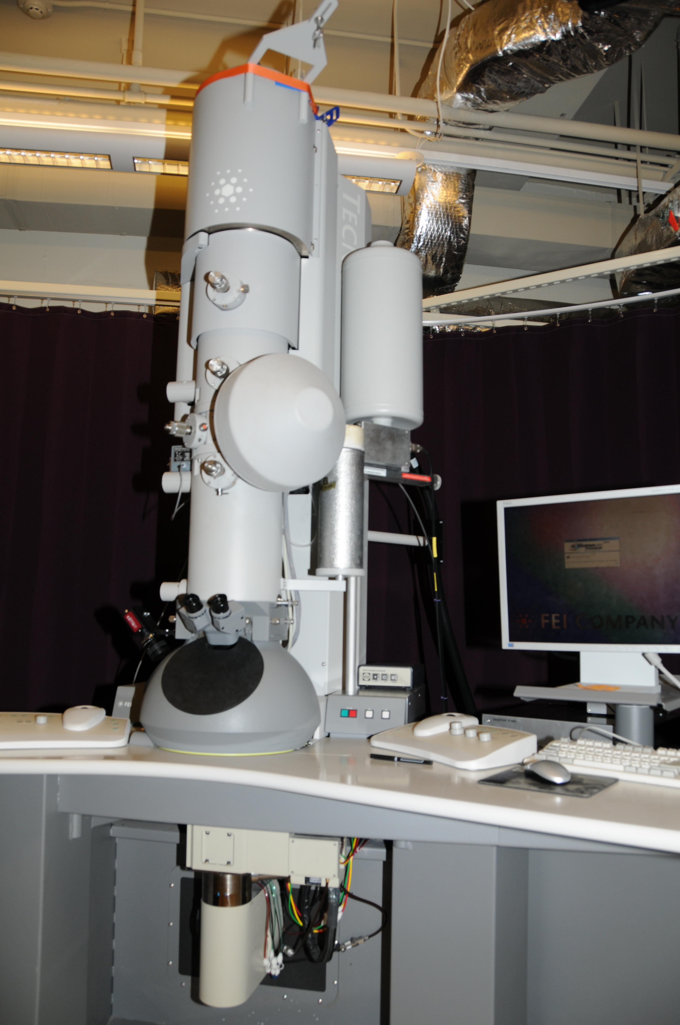

Slide 7
Objective Lens - Twin Lens System
The insertion of the minicondenser lens into the upper pole piece
A cross-over is created in the front-focal point of the objective-lens pre-field, producing a wide field of view and coherent illumination on the specimen

Slide 8
Diffraction Lens
Function: Diffraction focus in D / Image focus in LM
With the objective lens off, the diffraction lens is used for focusing the image.
focusing the diffraction pattern
How to adjust: Focus knob

Slide 9
Intermediate Lens
Function: Intermediate (Magnification, Imaging <-> Diffraction)
How to adjust: Imaging vs Diffraction; Magnification knob

Slide 10
Projection Lens (P1, P2)
Function: Magnification
How to adjust: Magnification knob

Slide 11
Use of Lenses
Bright Field Imaging Mode
Selected Area Diffraction Mode

